Slide 1

DeepLAW

Slide 2

Imagine situation

Slide 3
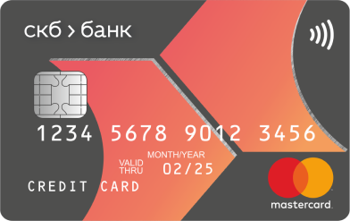
Imagine situation

Slide 4


Imagine situation

Slide 5



Imagine situation
БАНК

Slide 6
Imagine situation

Slide 7

Imagine situation

Slide 8

Neat questions

Slide 9
Questions People ask
“What can I do with old CD/DVD according to the law?”
“Am I denigrate the university if I’m telling my opinion?”
“Can I take a duck home from park?”
“Can I restrict my son from using the phone? Isn’t it his property?”
“Can I invite someone home if my co-owner doesn’t want it?”
. . .

Slide 10

WE HAVE THE SOLUTION!
Hello! My name is DeepLAW. I was created to serve people and help them with solving legal problems.

Slide 11
EASY TO USE
I have a problem with my card…
Here what the law says about your problem and what you should do next…

Slide 12


HOW TO ACHIEVE THIS
+
=
GPT-3

Slide 13


Multiple connections

Slide 14





Possible users

Slide 15
DeepLAW
IMPROVE THE WORLD TODAY

